Slide 1
NSW Digital Pet Registry
Communication toolkit for stakeholders
February 2025
Department of Planning, Housing and Infrastructure – Office of Local Government

Slide 2
Purpose of this toolkit
The NSW Digital Pet Registry has been enhanced so pet owners can pay registration, update their pet’s details, and more, online, without having to visit their local council.
Breeders and owners can also quickly and electronically transfer ownership of pets to new owners.
This toolkit has been developed to help councils communicate with their community about using the NSW Digital Pet Registry.
How to use this toolkit​:
This toolkit includes suggested text and tiles for websites, social media and newsletters. These assets can be easily used in information campaigns on your chosen media channels.
To download resources:​
Click on the accompanying link.
.Click ‘Download’ or right click to ‘Save’.
petregupgrade@olg.nsw.gov.au

Slide 3
Suggested website copy
Suggested copy has been prepared to inform pet owners and breeders about the NSW Digital Pet Registry.
The included document contains new website links that will take your audience to expanded information on the new NSW Pet Registry website, which is managed by the Office of Local Government.
Download word doc

Slide 4
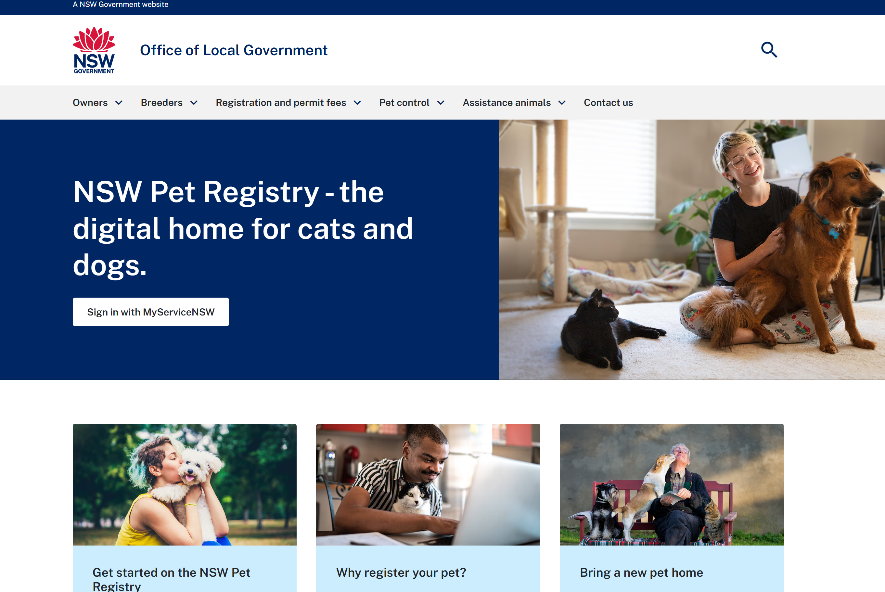
NSW Digital Pet Registry new website: key links
Get started on the NSW Pet Registry | https://www.petregistry.olg.nsw.gov.au/owners/get-started-nsw-pet-registry
Information for owners | https://www.petregistry.olg.nsw.gov.au/owners
Information for breeders | https://www.petregistry.olg.nsw.gov.au/breeders
Registration and permit fees | https://petregistry.olg.nsw.gov.au/registration-and-permit-fees
Pet Control | https://www.petregistry.olg.nsw.gov.au/pet-control
Paper forms | https://www.petregistry.olg.nsw.gov.au/registration-and-permit-fees/forms *
* The NSW Pet Registry has redesigned all paper forms for offline pet-related tasks. Please ensure links on your site are current.
petregistry.olg.nsw.gov.au

Slide 5
NSW Digital Pet Registry user factsheet
A digital factsheet has been prepared to assist owners with using the NSW Digital Pet Registry for the first time to register their pets, or to link their pets online.
Ctrl + click to download PDF

Slide 6
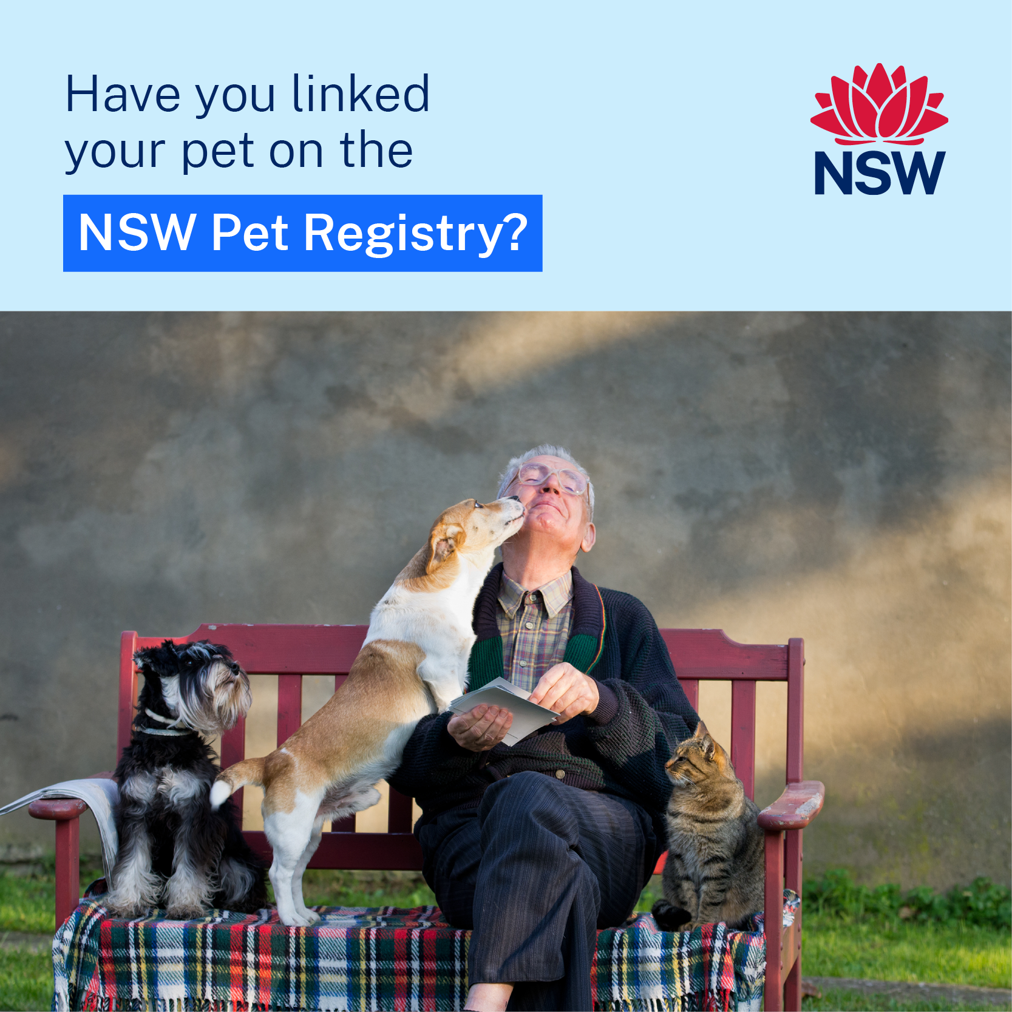
Suggested social media post: link my pet
Your pet is microchipped, but are they registered? 🤔
Check your pet’s registration status by creating an account on the NSW Digital Pet Registry – the official home of cats and dogs in NSW 🐶🐱
Simply search and link your pet to your account using their microchip number 💻
Once you and your pet are linked on the NSW Pet Registry, you can:
✅ check their registration status ✅ update their location ✅ make payments ✅ keep track of important events.
Get started today at www.petregistry.olg.nsw.gov.au 👈
Social-Tile-OLG_800x800_02_01
Social-Tile-OLG_800x800_02_02
Social-Tile-OLG_800x800_02_03
Social-Tile-OLG_1080x1350_01_01
Social-Tile-OLG_1080x1350_01_02
Social-Tile-OLG_1080x1350_01_03

Slide 7
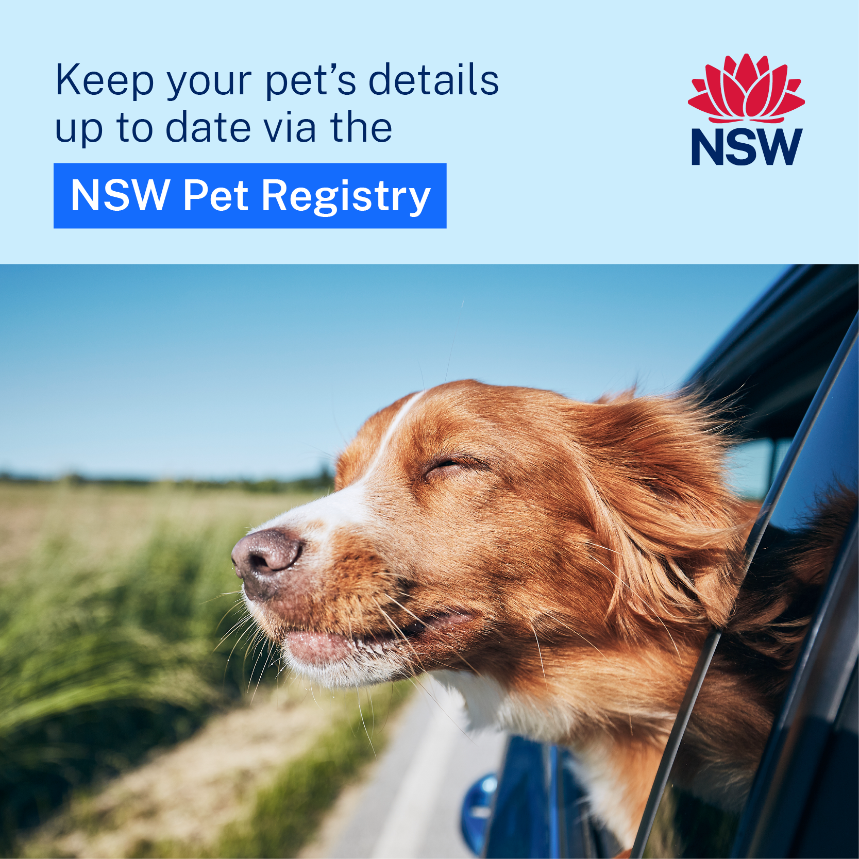
Suggested social media post: NSW Pet Registry
Did you know ❓ Your pet’s microchip is their passport for life.
Just like a passport, it’s important your pet’s details are updated in the NSW Digital Pet Registry – the official home for cats and dogs in NSW 🐶🐱
Simply follow these 3 easy steps, your pet will be right where they belong:
1️⃣ Create an account on the NSW Digital Pet Registry. 2️⃣ Link your pet using their microchip number. 3️⃣ Make sure their registration, desexed and location details are current and up to date.
Get started today at www.petregistry.olg.nsw.gov.au 👈
Social-Tile-OLG_800x800_02_04
Social-Tile-OLG_800x800_02_05
Social-Tile-OLG_800x800_02_06
Social-Tile-OLG_1080x1350_01_04
Social-Tile-OLG_1080x1350_01_05
Social-Tile-OLG_1080x1350_01_04

Slide 8
Leaderboard tiles
NSW-Pet-Registry_Leaderboard_728x90_02
NSW-Pet-Registry_Leaderboard_728x90_01
728x90
NSW-Pet-Registry_Leaderboard_320x50_01
NSW-Pet-Registry_Leaderboard_320x50_02
320x50

Slide 9
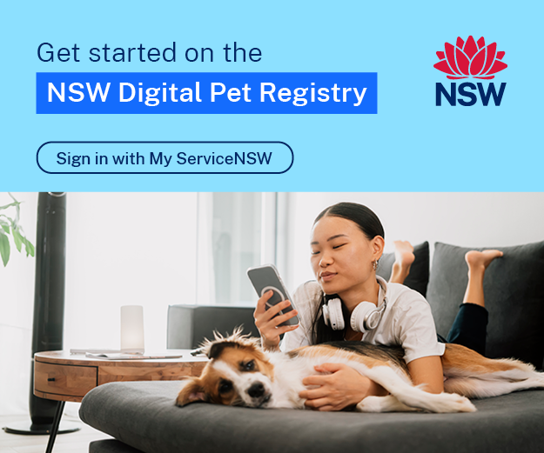
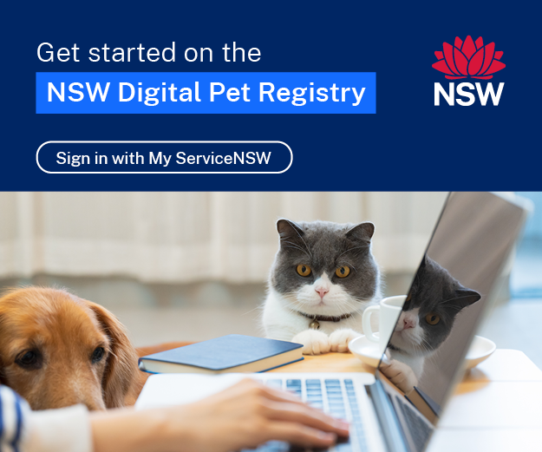
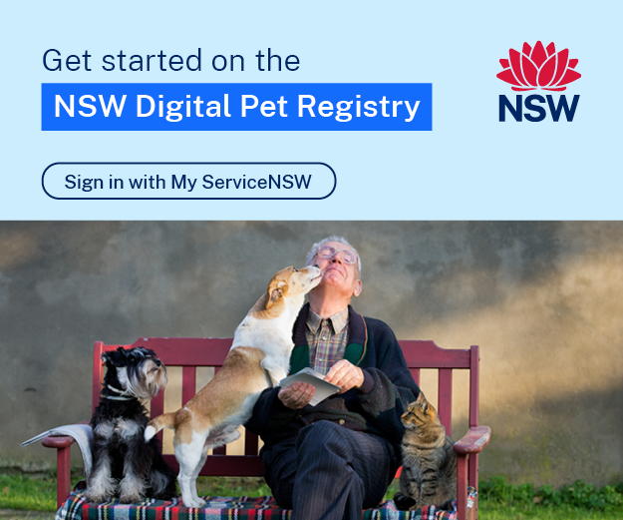
MREC website tiles 300x250
MREC-Tile-OLG_300x250_02_03
MREC-Tile-OLG_300x250_02_02
MREC-Tile-OLG_300x250_02_01

Slide 10
600x200 banners
Banner- OLG_600x200_01_01
Banner-OLG_600x200_01_02
Banner-OLG_600x200_01_03

